Slide 1
Celebration of the word
for secondary schools
Jubilee Year 2025:
Pilgrims of Hope

Slide 2
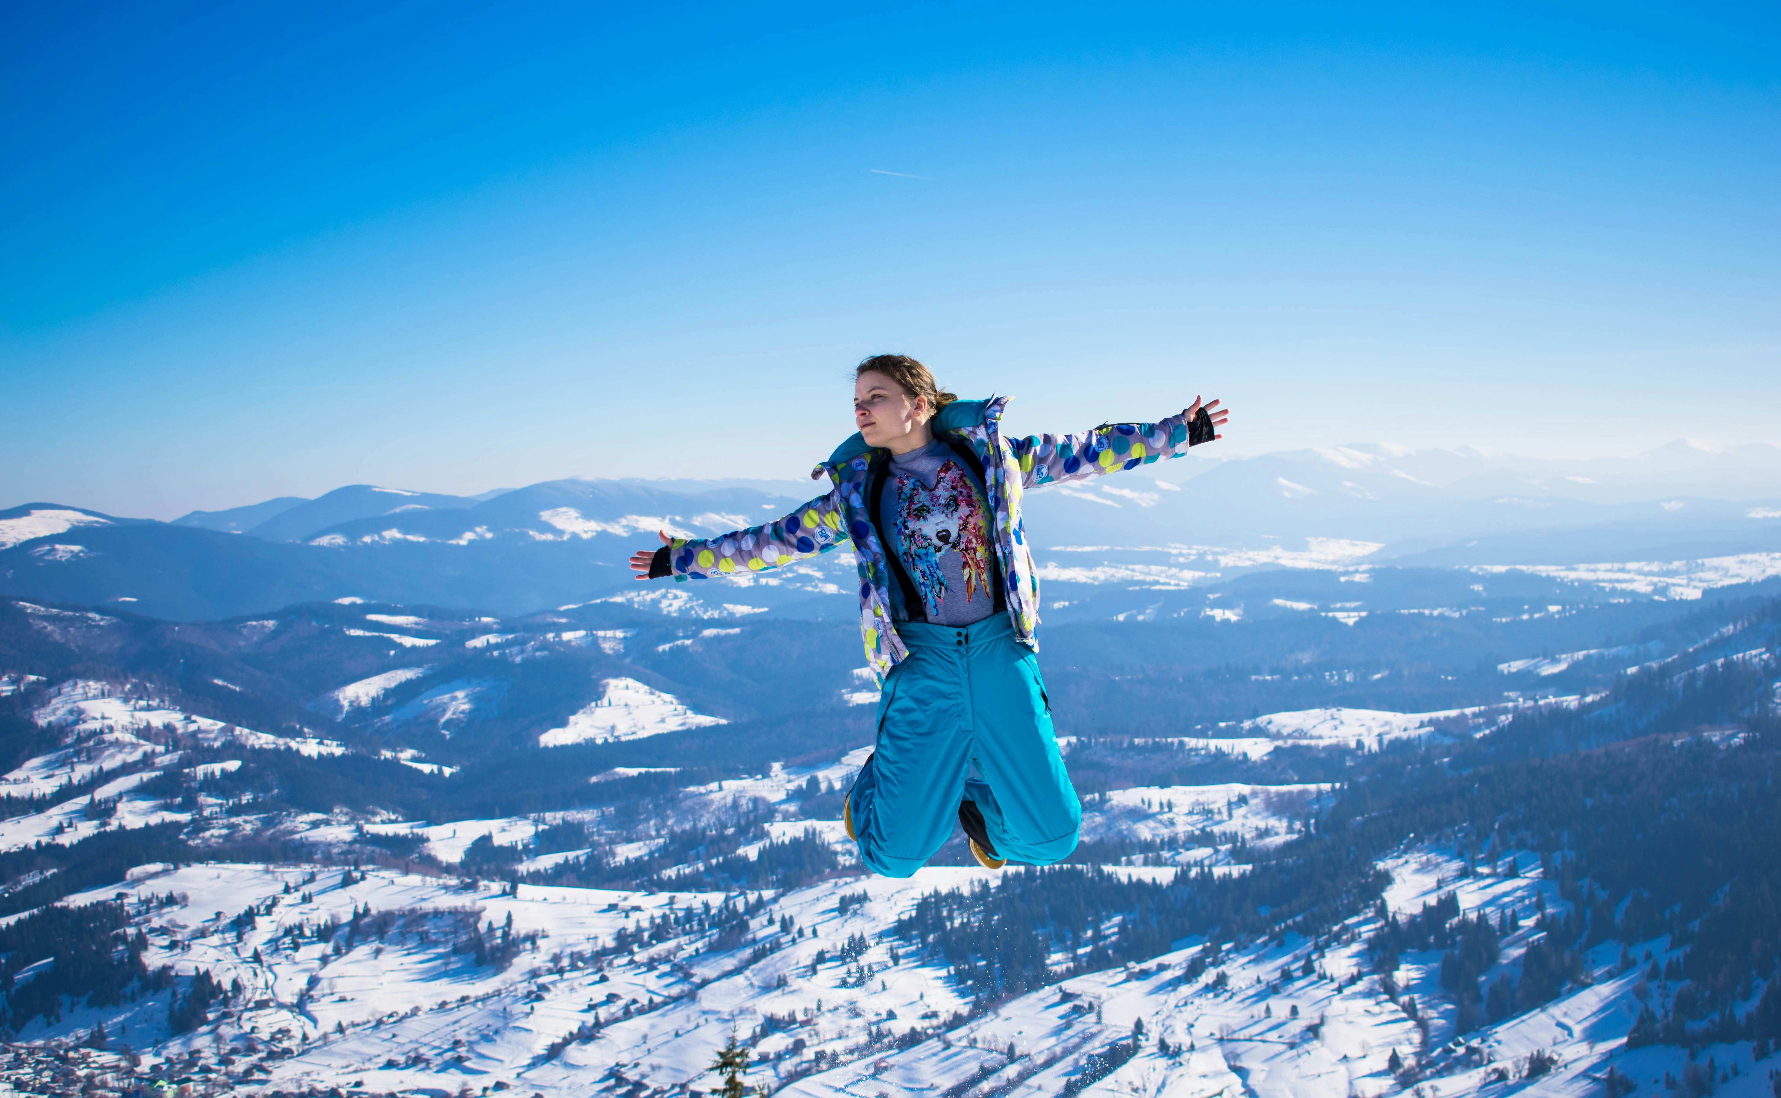
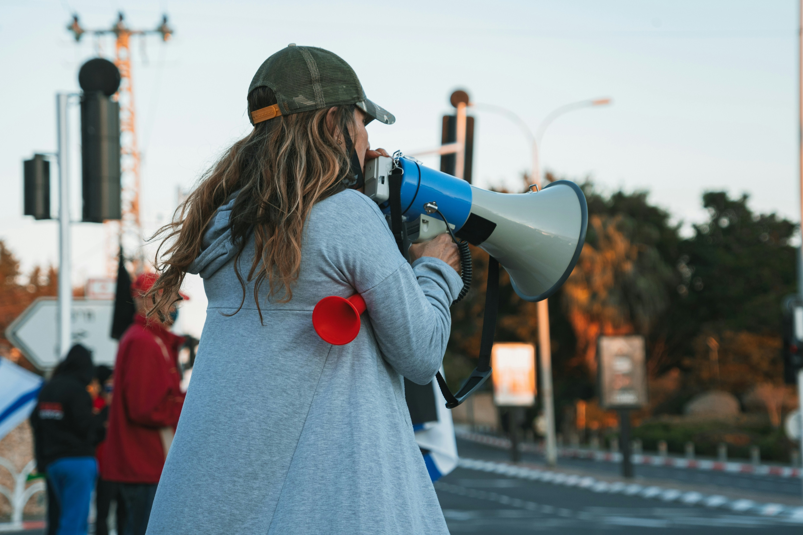
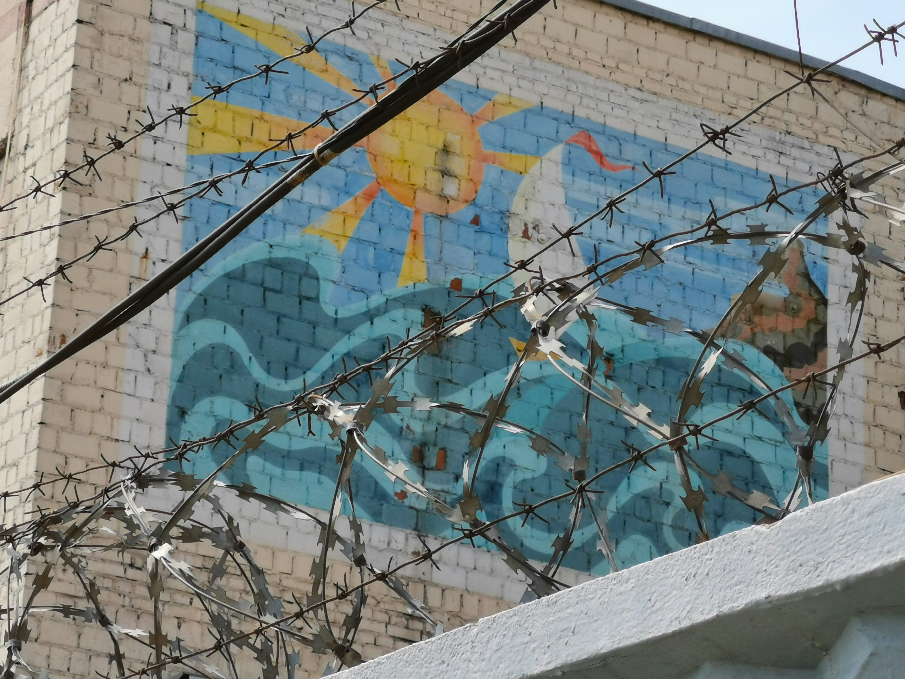
What does freedom look like?
Gather
Notes:
Give students two pieces of paper and a pen. On the first they can be asked what freedom looks like to them. They might want to draw on their paper. They might want to pick one of the pictures. They’ll need the second one later
Suggested music: Where The Spirit Of The Lord Is - Hillsong Worship - YouTube or https://www.youtube.com/watch?v=LlhquWiIkFc

Slide 3
Scripture reading Luke 4: 14-21 (ESV)
Word

Slide 4
In Luke 4 Jesus explains….
He has come for FREEDOM
He has come to RELEASE PEOPLE
He has come to bring LIGHT
He has come to RESTORE
He has come to bring JUBILEE for every person….!
Word

Slide 5
What is a Jubilee?
Respond

Slide 6
Jesus is allowed to read at his hometown synagogue
Jesus is tested in the wilderness
Jesus goes back to his hometown in Nazareth
Jesus declares he has come to fulfil Isaiah’s prophecy (written 700 years before his birth)
Jesus’ journey
Luke 4
He sets off on his journey and to complete his mission.
He makes his way to Jerusalem after stopping in various places.
Respond

Slide 7
Becoming responsible members
of our community
Discovering our passions and purpose
Times of celebration
Times to learn
Seeing different parts of the world.
What does our journey look like?
Helping those around us
Joy
Difficult times where we feel tested
Making friends
Respond

Slide 8
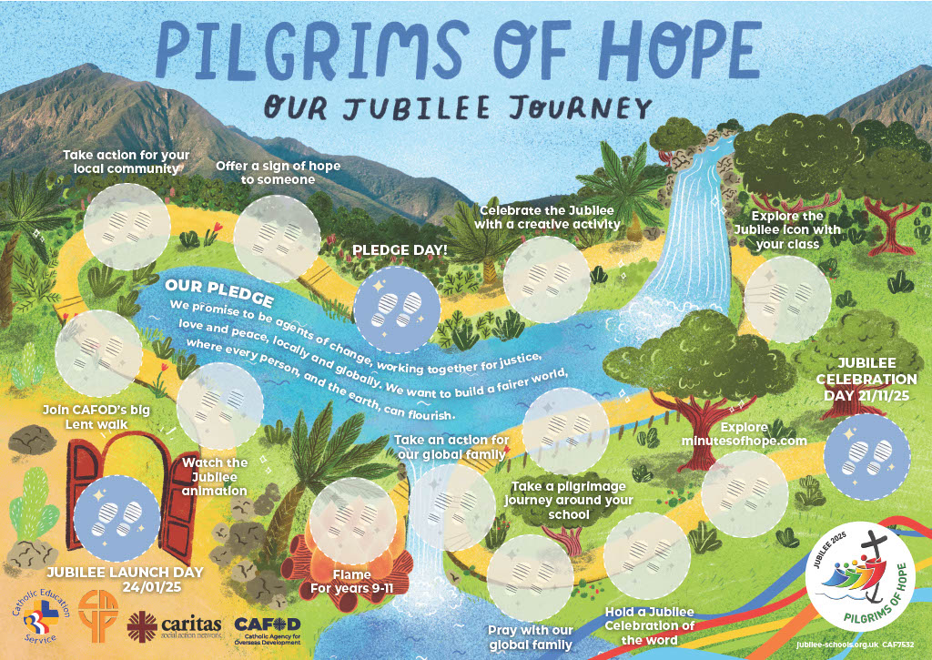
2025 is a special year to proclaim Jubilee.
We’re going on a journey as Pilgrims of Hope.
Respond

Slide 9
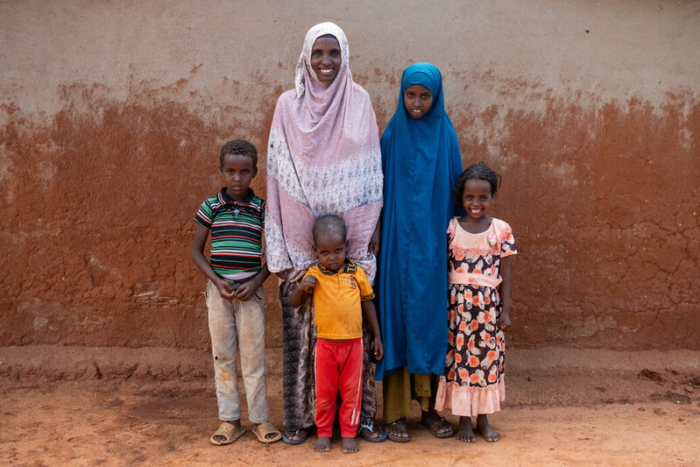
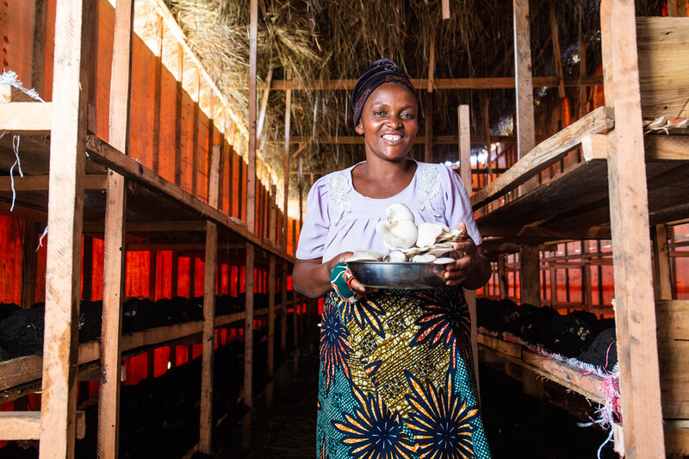
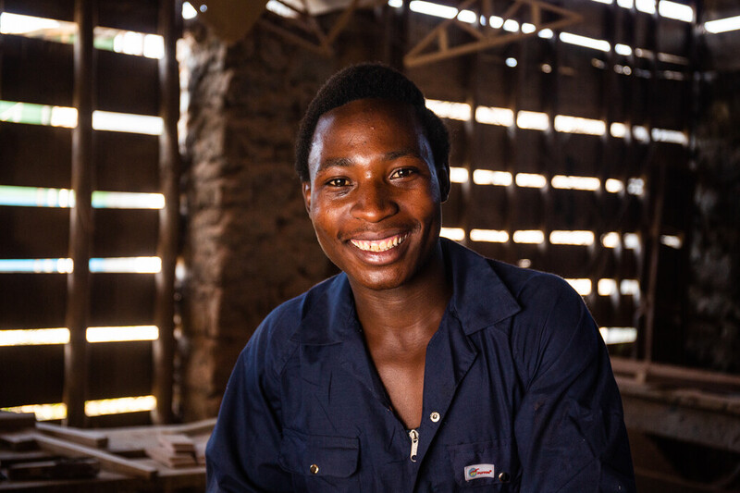
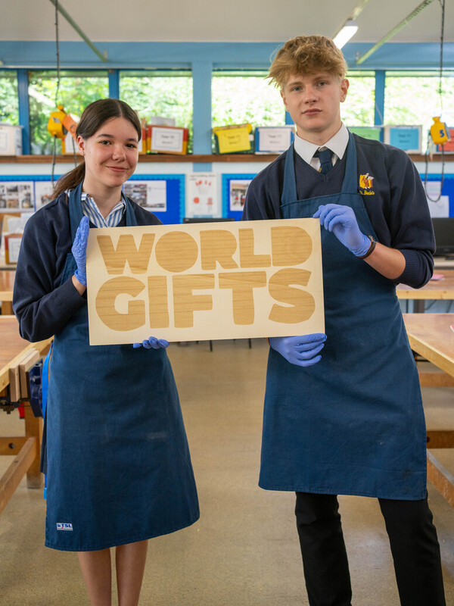
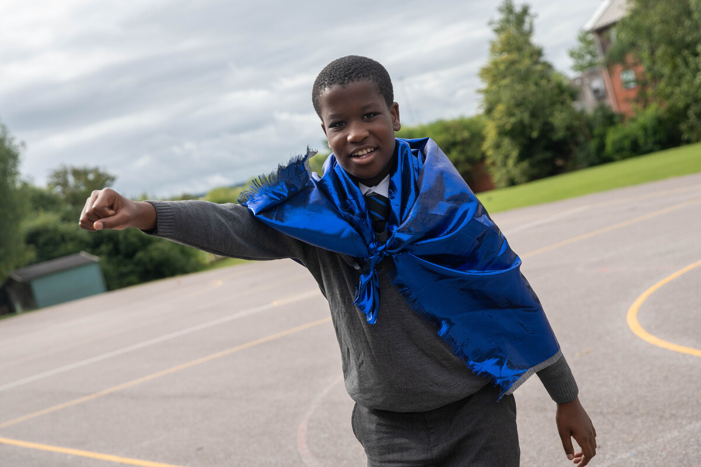
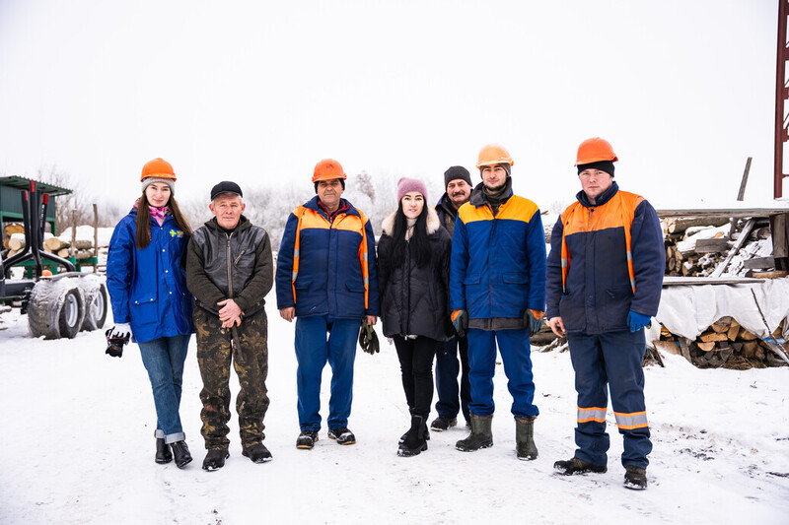
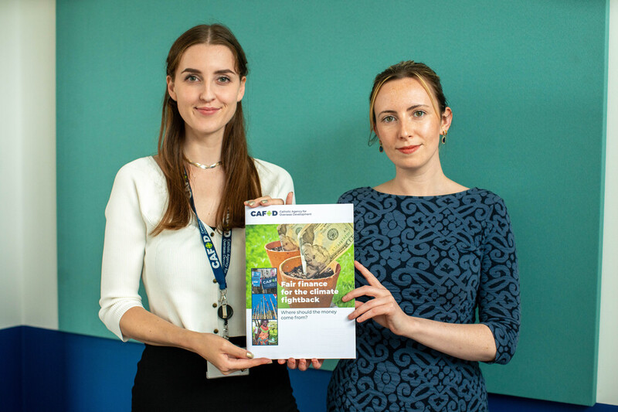
Bernadette, Farming project, DRC
Daniel, Woodworking project, DRC
Khera, Chicken project,
Kenya
“We are agents of change
because we are disciples of Christ.”
Cardinal Vincent Nichols
Ikam, Brighten Up, UK
St Bede’s students, World Gifts, UK
Caritas Ukraine, Firewood project, Ukraine
Liz and Maria, CAFOD Fair Finance policy, UK
Agnjetschka, Soup kitchen, Poland
Send

Slide 10
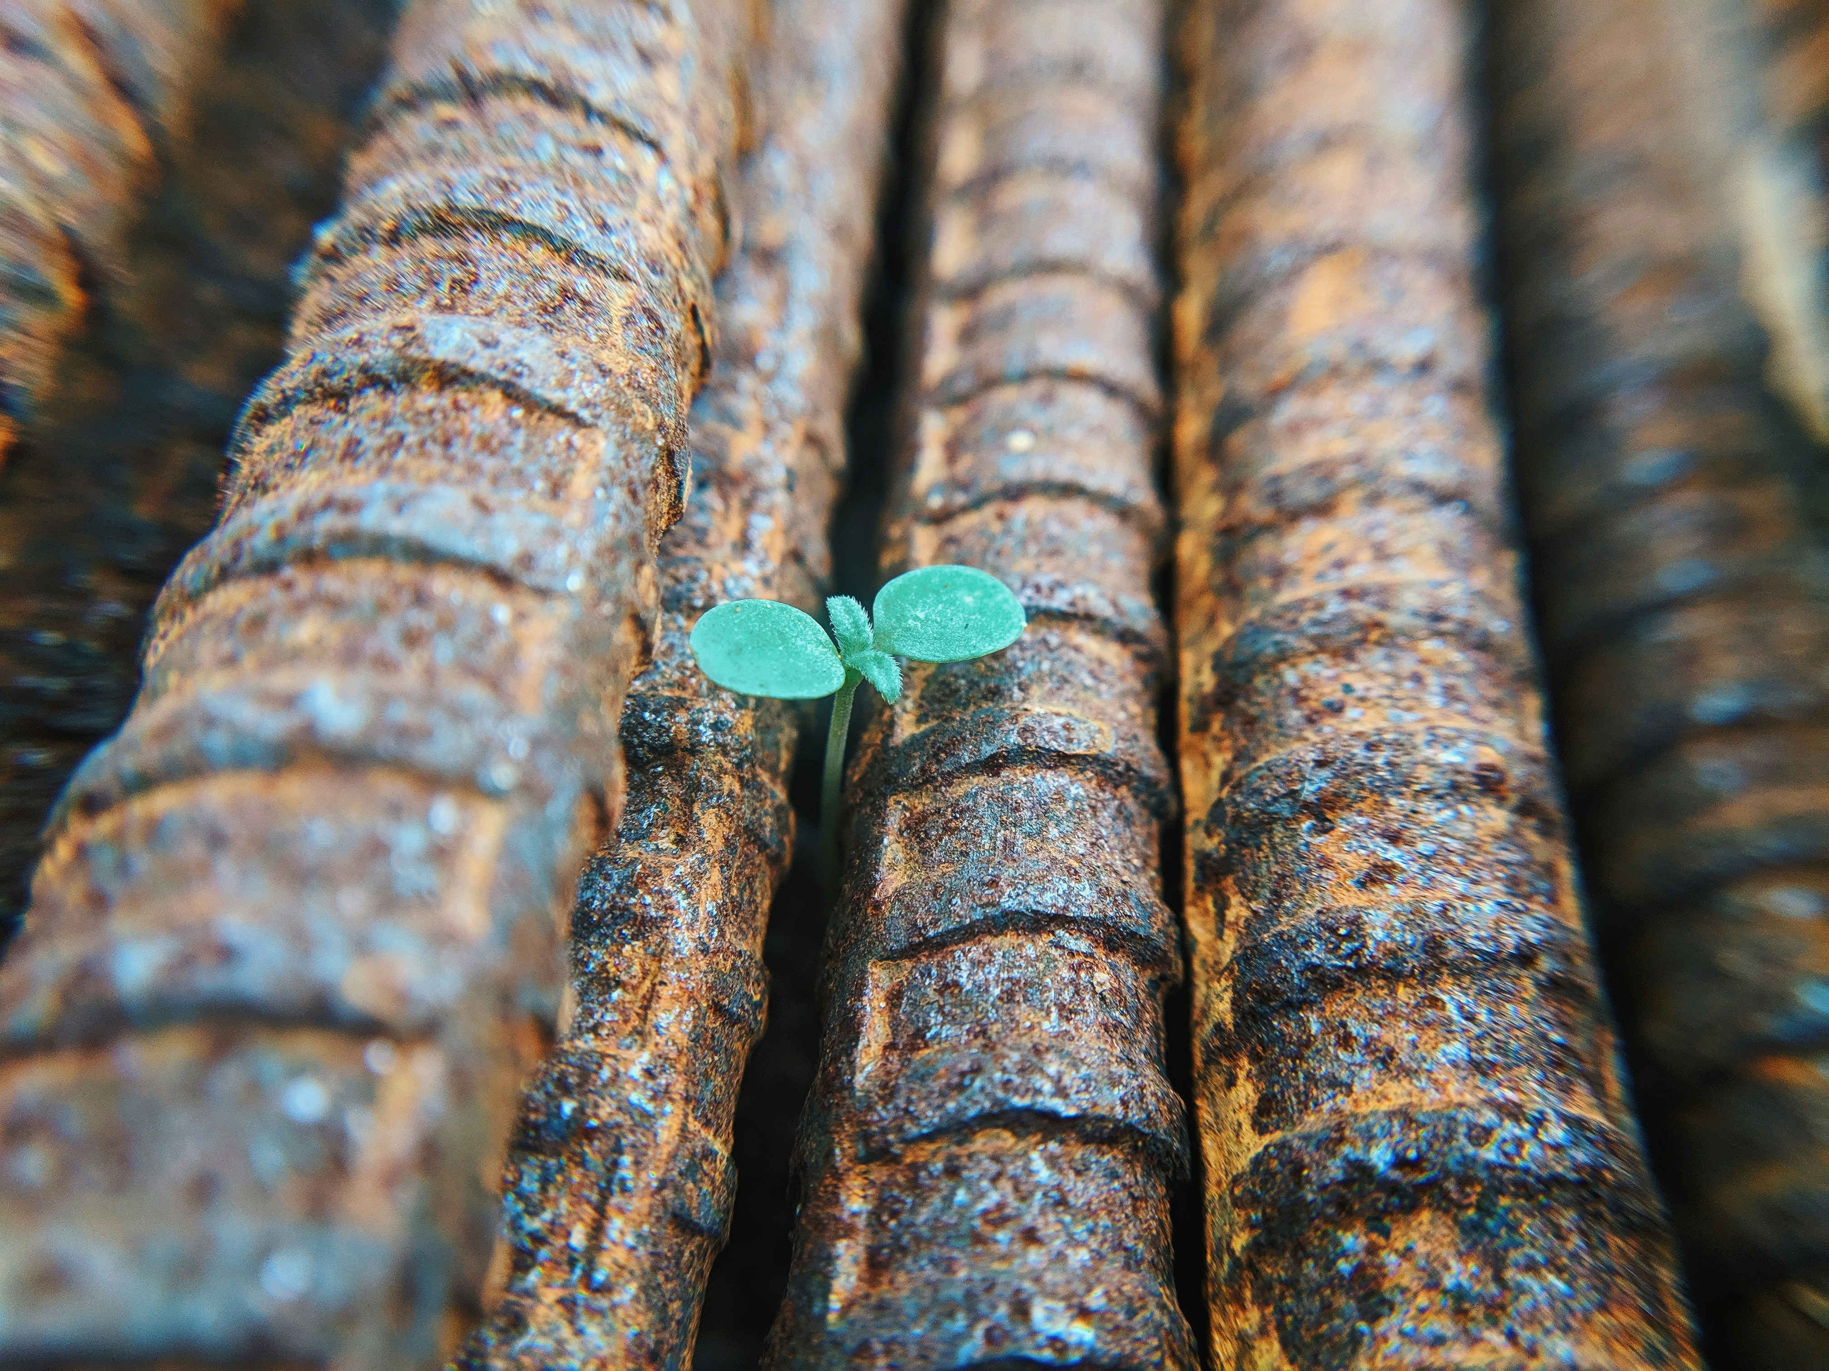
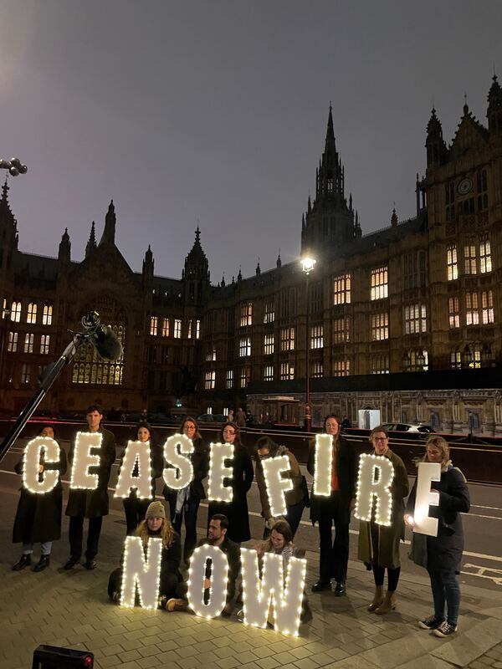
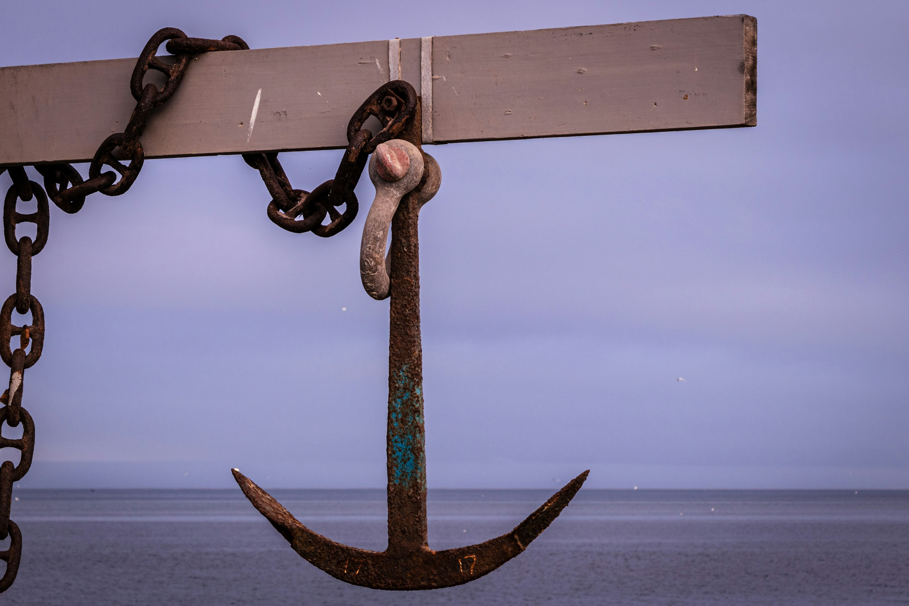
What does hope look like to you?
Send
Notes:
Spend time asking the students to draw a symbol or write down what hope looks like to them. They might just want to pick one of the images suggested.
Suggested song: Yet Not I but Through Christ in Me (Cover) - Hillside Recording & Tenielle Neda

Slide 11
Jubilee Prayer of Hope
Send

Slide 12
Jubilee Prayer of Hope
God, our loving Father,
In this Jubilee year, you remind us of our call to love creation.
Help us to work together to replant, repair, and renew.
Guide us on our journey as pilgrims of hope.
Send

Slide 13
Jubilee Prayer of Hope
Jesus, our light,
In this Jubilee year, you remind us of our call to love our neighbours and to set free those who suffer.
Help us to treat everyone with dignity; to be fair; forgiving; and kind.
Guide us on our journey as pilgrims of hope.
Send

Slide 14
Jubilee Prayer
Holy Spirit, our inspiration,
In this Jubilee year, you remind us of our call to grow in faith and love.
Help us to hear you in scripture, to see Jesus in others, and to feel united as God’s global family.
Guide us on our journey as pilgrims of hope.
Amen
Send

